Slide 1
BITS Pilani
Dr.Aruna Malapati
Asst Professor
Department of CSIS

Slide 2
Information Retrieval (CS F469)

Slide 3

Today’s Agenda
General course information
Objectives
Reasons to take this course
Course Logistics
Course outline
Introduction to Information Retrieval

Slide 4
General Course Information
Instructor: Dr. Aruna Malapati
Office: B226
Email: arunam@hyderabad.bits-pilani.ac.in
Chamber Consultation : Thursday 4:00-5:00pm

Slide 5
Objectives
Introduce the field of Information Retrieval (IR).
  Basic foundation, Principles, Methods etc.
  Trends: Frontier Topics
Prepare you to take up challenges in IR or related fields.

Slide 6
Reasons to take this course
Information changes people’s life.
Users need to find useful information: Very HUGE amount of data.
Industries need to earn money through search engines: Google, Yahoo, Bing, Baidu, SoSo, Sogou, etc.
Many interesting problems in IR field haven’t been solved.

Slide 7
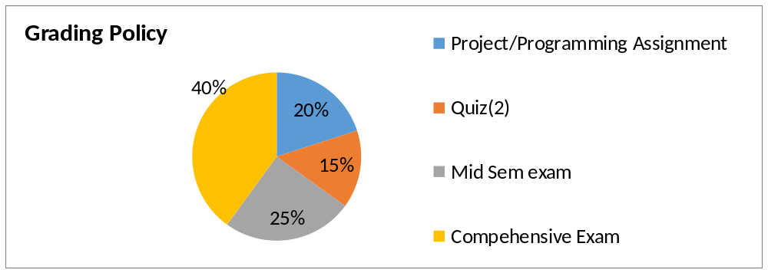
Course Logistics
No Makeup for quizzes dates will be announced by 7/8/2017

Slide 8
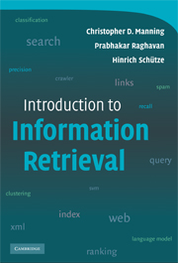
Text Book

Slide 9
Course Outline
Overview of IR
Text and vector space classification
Cross Language Information Retrieval(CLIR)
Multimedia Information retrieval(MIR)
Recommender systems
Web search

Slide 10
Why IR?
Web Sites Increasing Sharply
Internet Users Increasing Continuously
Current Web (1 billion users more than 1000 billion pages)
Google
  3 billion documents indexed
  10-20 TB of text on web
  ~ 1000 TB of information produced every year

Slide 11
How big Facebook’s data?
2.5 billion content items shared per day (status updates + wall posts + photos + videos + comments)
2.7 billion Likes per day, 300 million photos uploaded per day
100+ petabytes of disk space in one of FB’s largest Hadoop (HDFS) clusters
105 terabytes of data scanned via Hive, every 30 minutes
70,000 queries executed on these databases per day
500+terabytes of new data ingested into the databases every day

Slide 12
Keywords in IR
A large repository of documents are stored on computers. (Corpus).
There is topic about which I desire to get information (Information need).
Some of the documents may contain the information that satisfies my need (Relevance).
How do I retrieve these documents?
I communicate my information need in the form of a query.

Slide 13
Structured data
How the query is expressed will depend on whether the data in the document corpus is structures / unstructured.
Structured data tends to refer to information in “tables” and has a clear, overt semantic structure.
Employee | Manager | Salary
Smith | Jones | 50000000
Chang | Smith | 60000
Ivy | Smith | 50000

Slide 14
Structured data
Structured data allows for expressive queries like:
Give me the social security numbers of all the employees who have stayed with company for more than 5 years, and whose yearly salaries are three standard deviations above average salary.
Employee | Manager | Salary
Smith | Jones | 50000000
Chang | Smith | 60000
Ivy | Smith | 50000
Database Systems

Slide 15
Unstructured
Unstructured data does not have clear, overt semantic structure(e.g, free text on a web page, audio, video).
Allows less expressive queries of the form:
Give me all documents that have keywords ‘These Romans are crazy’.
Structured data
Database systems
Unstructured data
Information retrieval

Slide 16
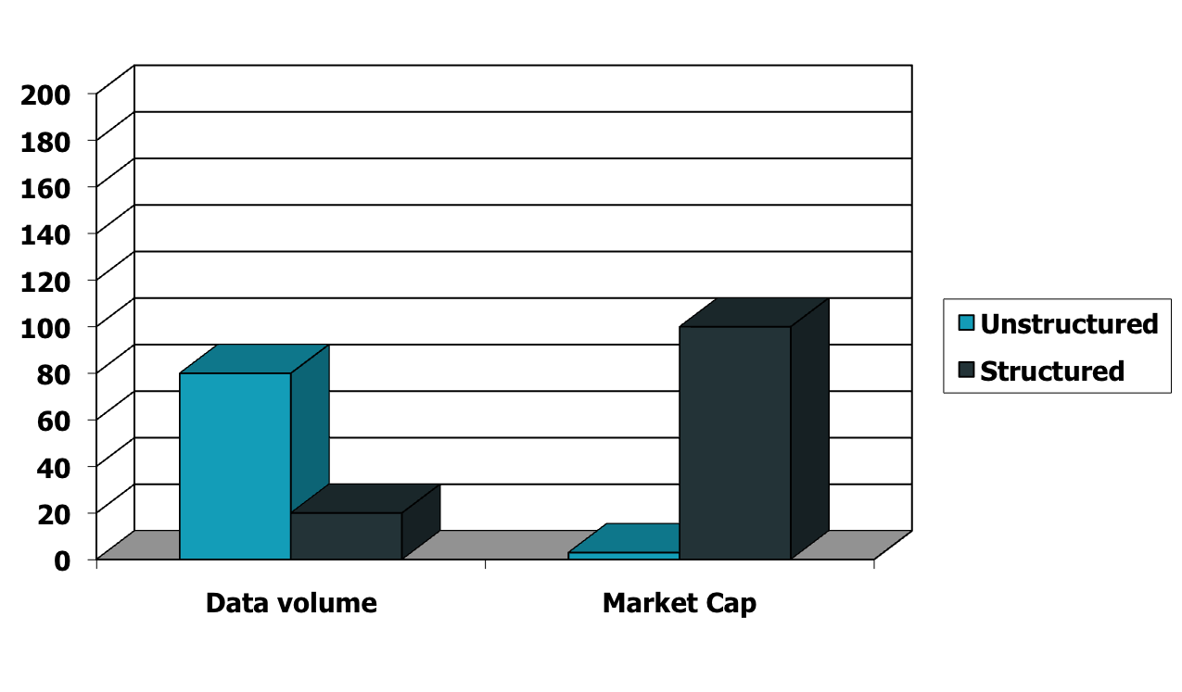
Unstructured (text) vs. structured (database) data in 1996

Slide 17

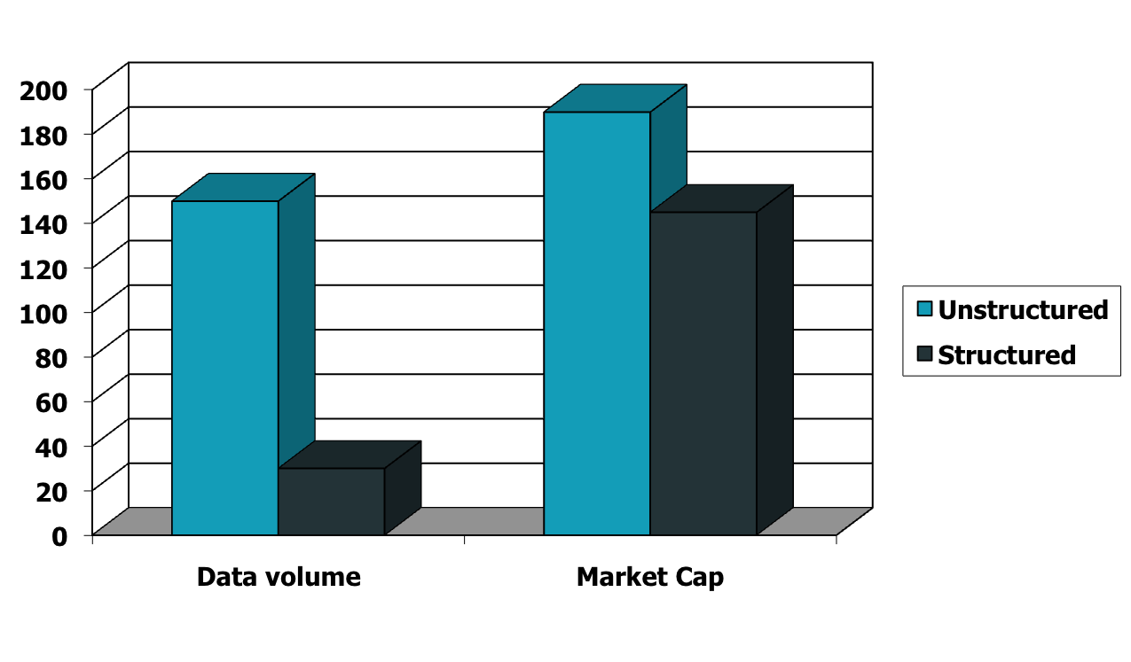



Unstructured (text) vs. structured (database) data in 2009

Slide 18
Semi structured data
In reality, almost no data is truly “unstructured”.
E.G this slide has distinctly identified zones such as Tiles and Bullets.
Headings, paragraphs and footnotes represented by explicit mark up.
Semi-structured data facilitates queries such as
Give me all documents in which the title contains data and Bullets contain search.

Slide 19
Information Retrieval
Information Retrieval (IR) is finding material (usually documents) of an unstructured nature (usually text) that satisfies an information need.

Slide 20


The problem of IR
Goal = find documents relevant to an information need from a large document set
Info. need
Query
Document
collection
IR system
Retrieval
Answer list

Slide 21
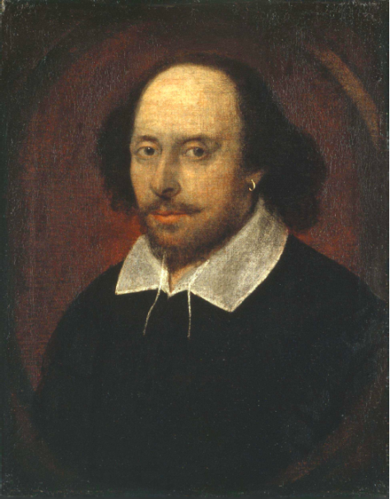
An example IR problem
Document corpus = Shakespeare’s written plays(37).
Information needed = Which plays of Shakespeare contain the words BRUTUS AND CEASAR but NOT CALPURNIA.

Slide 22
Naïve solution
Linear scan through all the plays of Shakespeare (‘grepping’)
  Need to repeat this for every query.
  Works for Shakespeare’s plays, but may not work on huge documents collections (billions / trillions of words)
  Can we cut down the time?
Better solution: Preprocess the Corpus in advance and organize the information about the occurrence of different words in a way that speeds up query processing.

Slide 23
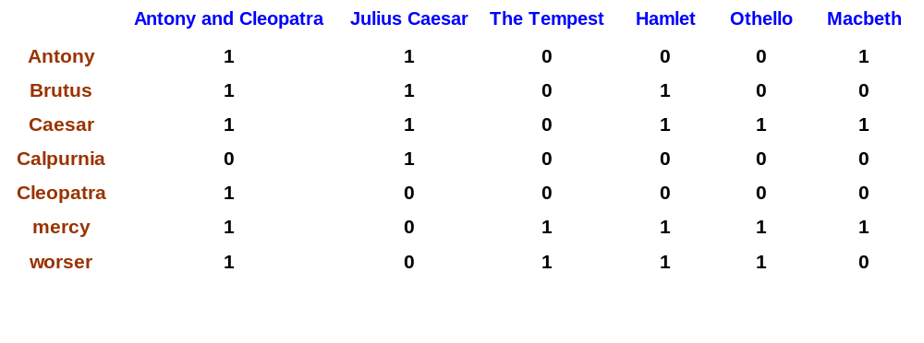
Term-document incidence
Brutus AND Caesar BUT NOT Calpurnia
1 if play contains word, 0 otherwise

Slide 24
Incidence vectors
So we have a 0/1 vector for each term
To answer query: Brutus, Caesar and NOT Calpurnia take the vectors for
Brutus 110100
Caesar 110111
Calpurnia (complemented) 101111
Bitwise AND
110100 AND 110111 AND 101111 = 100100

Slide 25
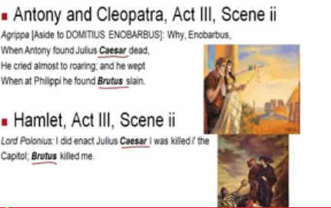
Answers to query
http://www.rhymezone.com/shakespeare/

Slide 26
Realistic Scenario
Consider N = 1 million documents, each with about 1000 words.
Each word Avg 6 bytes/ word including spaces/punctuation
  6GB of data in the documents.
No of distinct terms ~ 5,00,000
I Million columns
5,00,000
Distinct
words

Slide 27
A realistic scenario
No of cells in the term document matrix = 500000x10⁶ = 0.5x10¹² = 0.5 trillion (too much for memory)
If we want to store 0.5 trillion cells in memory how much memory do you need?
If each cell takes 1 byte then we need 0.5x10¹² bytes (i.e 500 GB) in main memory (No common PC in market have this big RAM size)
If each cell takes 1 Bit then we need 500GB/8 still not feasible.
Run out of space for 1 million news documents.

Slide 28
Term-document matrix is sparse
Max % of 1’s possible in a
column vector
= (1000/500000)*100
= 10⁵/500000
= 1/5 = 0.2%
Max number of 1’s = (#documents) * (#words in each document) = 1 million * 1000 = 1 billion.
Since total #cells in matrix = 0.5 trillion, at most 0.2% of the cells can have a 1.
Max % of 1’s possible in a
column vector
= (10⁹/0.5*10¹²)*100
= 1/5 = 0.2%

Slide 29
Summary
Course related stuff.
IR is the current trend in research due to unstructured data Tsunami.
A simple IR example for Shakespeare’s written plays.

